Slide 1
Objectives
After completing this chapter you will be able to,
  Describe about JDBC.
  Understand the internal working of JDBC.
  List out the types of JDBC Drivers.
  Explain the working of the JDBC APIs.

Slide 2








Let us learn JDBC with a real time example
The travel agent processes the documents, fills out the required forms and hands it over to the appropriate Visa Immigration team Example: Italy Immigration team is given the docs to get the Italy visa
A business woman needs to travel on a world tour and is in need of a VISA for U.S, Singapore and Italy.
.
US Consulate
USA
Singapore
Singapore
Consulate
Italy
Italy
Consulate
The division agents verify the forms and reach out to the corresponding embassy office for the VISA. Finally, the VISA is dispatched to the business woman
She approaches a travel agent who collects all the required information and documents from the business woman.

Slide 3

JDBC – Real world Analogy
Now let us look at the analogy between JDBC and the VISA Example
Relates to Java Client which needs to access the database.
Relates to JDBC API used for querying database.
Relates to database specific JDBC Drivers for querying the appropriate database.
Relates to various database like Oracle, MySQL etc.

Slide 4
What is JDBC?
What is JDBC?
  Java DataBase Connectivity (JDBC) is a set of standard Java API’s that allows programmers to access the database management system from java code.
  The JDBC API defines the Java interfaces and classes that are programmers friendly, these can be used to connect to databases and send and execute queries.
J
D
B
C
A
P
I
Database
Java Programs
JDBC API’s comes under the package java.sql

Slide 5
What is a JDBC driver?
What is a JDBC Driver?
  A JDBC driver is a core software component of JDBC API that enables Java application to interact with a database.
  In JDBC the communication happens between the java application and the database via Drivers.
  Different databases have different JDBC drivers like Oracle, MYSQL have their own drivers.
  These drivers are nothing but Java classes bundled in jar file and provided by the appropriate database vendors like Oracle, MySQL.
Functions of JDBC Drivers:
  The JDBC Driver establishes the connection with the database.
  The JDBC Driver implements the protocol for transferring the query and result between Java Program and database and vise versa.
A JDBC driver is a Java class that implements the JDBC’s java.sql.Driver interface

Slide 6
JDBC drivers Illustration
Oracle Driver
Oracle Database
Java Program
JDBC API
User program uses JDBC API to query database.
MySql
Driver
MySql Database
JDBC API in turn uses the respective drivers to query the database.
Informix
Driver
Informix
Database
JDBC Driver are hidden to the Java Program. JDBC API will take care of mediating java program with drivers to access the appropriate database.

Slide 7
Lets Look at the JDBC API’s
Let us all see how the JDBC API invocation happens?
Using DriverManager API the appropriate database vendor drivers are loaded.
Using SQLConnection API the connection is established with the database.
Using Statement/PreparedStatement API the queries are sent and executed
in the database engine
Java
Program
JDBC API
D
R
I
V
E
R
java.sql.DriverManager
Database
java.sql.Connection
java.sql.Statement (or)
java.sql.PreparedStatement

Slide 8
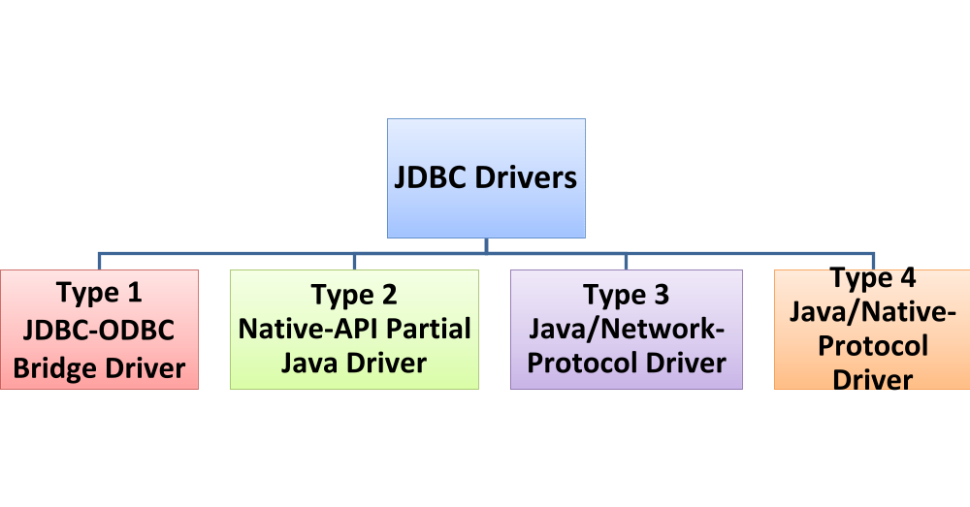
Types of JDBC Drivers
The JDBC API connects to the database using the JDBC servers.
JDBC drivers fit into one of four categories.

Slide 9
Type 1 Driver
Type 1 Driver - JDBC-ODBC Bridge Driver.
      The Type 1 driver translates query obtained by JDBC into corresponding ODBC query, which is then handled by the ODBC driver. ODBC is a generic API.
      The JDBC-ODBC Bridge driver is recommended only for experimental use or when no other alternative is available.
Client Tier
Java Application
JDBC API
The Client machine should have the JDBC –ODBC bridge and ODBC installed.
JDBC-ODBC Bridge
ODBC Driver
Data Source

Slide 10
Advantages and Disadvantages Type 1 Driver
  Advantages:
    Easy to connect.
    The JDBC-ODBC Bridge allows access to almost any database
  Disadvantages:
    Since the Bridge driver is not written fully in Java, Type 1 drivers are not portable.
    They are the slowest of all driver types.
    The client system requires the ODBC Installation to use the driver.
Example: sun.jdbc.odbc.JdbcOdbcDriver

Slide 11
Type 2 Driver
Type 2 Driver - Native-API Partial Java Driver.
      The JDBC type 2 driver, also known as the Native-API driver, is a database driver implementation.
      It converts JDBC calls into database specific calls i.e. this driver is specific to a particular database.
Client Tier
Java Application
JDBC API
The Client machine should have the JDBC and Native API driver installed.
Native API Driver
Native API
Data Source

Slide 12
Advantages and Disadvantages Type 2 Driver
Advantages:
  Better Performance than type 1 because these drivers uses native API calls which are database specific.
Disadvantages:
The vendor client library needs to be installed on the client machine.
Not all databases have a client side library
This driver is platform dependent
This driver supports all java applications except Applets

Slide 13
Type 3 Driver
Type3 Driver –Java/Network-Protocol Driver
      The type 3 database requests are passed through the network to the middle-tier server.
      The middle-tier then translates the request to the database. If the middle-tier server can in turn use Type1, Type 2 or Type 4 drivers.
Client Tier
Java Application
JDBC API
The Client machine should have only the JDBC API.
Middle Tier
App 1
App 2
Middle Tier could be the same or another machine will have any of the JDBC drivers.
App server
3-tier JDBC Driver
Data Source

Slide 14
Advantages and Disadvantages of Type 3 Driver
Advantages:
  Type 3 driver is fully written in Java and hence Portable. It is suitable for the web.
  Supports features such as caching , load balancing, and advanced system administration such as logging and auditing.
  Type 3 driver designed to make the client JDBC driver very lightweight and fast to load.
Disadvantages:
  Requires database-specific coding to be done in the middle tier.
  The middleware layer added may result in additional latency, but is typically overcome by using better middleware services.

Slide 15
Type 4 Driver
Type4 Driver – Native-Protocol Driver.
    The Type 4 uses java networking libraries to communicate directly with the database server also called as Thin driver.
    Converts JDBC calls directly into a vendor-specific database protocol.
Type 4 Driver is most commonly used in Projects
Client Tier
Java Application
JDBC API
Thin/Type 4 Driver
Native Protocol
Data Source

Slide 16
Advantages and Disadvantages Type 4 Driver
Advantages:
  Type 4 JDBC drivers are completely written in Java to achieve platform independence.
  It is most suitable for the web based applications.
  Type 4 drivers provides better performance because translation layers are very less.
Disadvantages:
  Type 4 drivers are database dependent. That is Oracle will have its own driver and MYSQL will have its own drivers.

Slide 17
JDBC API’s in detail
Let us now look at the JDBC API’s in detail:
java.sql.DriverManager
java.sql.Connection
java.sql.Statement
java.sql.PreparedStatement
java.sql.CallableStatement

Slide 18
java.sql.Driver
java.sql.Driver:
  The java.sql.Driver interface contains methods that every database specific driver must implement.
  Each database should provide a class that implements the java.sql.Driver interface.
  Click on the below link to view the API of java.sql.Driver Interface
  http://docs.oracle.com/javase/6/docs/api/java/sql/Driver.html

Slide 19
java.sql.DriverManager
java.sql.DriverManager
  The java.sql.DriverManager class is responsible to load and register the appropriate database specific driver based on the input provided by the client program.
  Say for example, if client sends Oracle this will load and register Oracle driver.
  The registerDriver method is used to register the given driver with the DriverManager.
  Click on the below link to view the API of java.sql.DriverManager Class http://docs.oracle.com/javase/6/docs/api/java/sql/DriverManager.html

Slide 20
java.sql.Connection
java.sql.Connection:
  After loading the driver, the connection is established with the database server using java.sql.Connection API.
  For establishing connection, we will logon to the database with user name and password.
  Connection interface is used for sending a series of SQL queries to the database and execute the SQL queries in the database engine.
Click on the below link to view the API of java.sql.Connection:
http://docs.oracle.com/javase/6/docs/api/java/sql/Connection.html

Slide 21
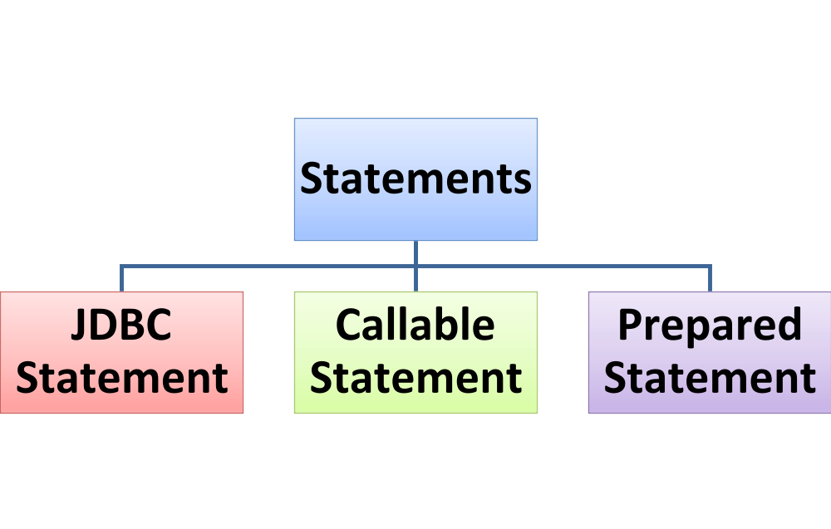
java.sql.Statement
java.sql.Statement:
  After establishing a connection with a database, it is now time to prepare the query/statement to be executed.
  There are three types of statement interfaces, that enable you to send SQL or PL/SQL commands and receive data from the database
Used for executing procedures and functions
Recommended for executing DDL queries (or) Select queries with no inputs.
Recommended for executing Select queries and DML queries.

Slide 22
java.sql.Statement
java.sql.Statement
  Before you use a statement object to execute a SQL, you need to use the Connection object to either create a prepare or statement or callable statement based on the need.
  Statement Syntax:
  Statement stmt = conn.createStatement( );
  PreparedStatement Syntax:
  PreparedStatement pstmt = conn.prepareStatement(SQL);
  CallableStatement Syntax:
  CallableStatement cstmt = conn.prepareCall (SQL);

Slide 23
JDBC Exceptions
In JDBC, the most common exception is java.sql.SQLException.
The SQLException class extends the general java.lang.Exception class..
A SQLException can occur when connecting or executing SQL’s.
The SQLException provides the following information ,
  A message describing the root cause error. This is available using the getMessage() method on the SQLException object.
  A vendor-specific, integer-error code, available using the getErrorCode() method. Normally, this is the actual error code that the underlying database returns.
You will learn more about implementing SQL Exception in the next session.

